Slide 1
A D.R.I.V.E. CAPSTONE PROJECT
Meridian Pictures
Data-Driven Production Strategy for a $500M Investment
Boluwatife Bankole
OptiaHQ BI & Analytics Masterclass Capstone | July 2026
Notes:
Welcome — this is a 10-minute walkthrough of my BI capstone for Meridian Pictures, following the D.R.I.V.E. framework: Define, Retrieve, Insight, Visualise, Execute.

Slide 2
DEFINE
The Business Problem
THE DECISION
Meridian Pictures wants to invest $500M in its next films, and needs to know based on what has worked in the past, which kinds of films are likely to be profitable without reducing the quality they are known for.
The Executive Team is choosing which genres, budget band, film lengths, and directors to back when allocating the $500M.
$500M
10,865
3,854
Investment under
consideration
Total films analysed
(1960 – 2015)
Films with reliable
budget & revenue data
2
Notes:
Meridian's executive team needs to decide how to allocate $500M across genres, budgets, runtimes and directors — profitably, without hurting the studio's reputation for quality.

Slide 3
DEFINE
How We'll Measure Success
Profit
ROI
Average Rating
Film Count
revenue_adj − budget_adj
Profit ÷ budget_adj
vote_average
Count of valid films
Why adjusted (2010-dollar) figures?
Why exclude $0 budget/revenue rows?
The dataset is from 1960 to 2015, raw budget and revenue figures aren't comparable across decades due to inflation. Inflation here means a dollar in the 1960s bought far more than a dollar in the 2010s. Using the adjusted columns converts every film's budget and revenue into 2010 dollar equivalents, so decades can be compared fairly. Without this adjustment, later decades would appear more profitable simply because of rising costs and prices, not because the films themselves performed better.
A $0 value means the figure was never recorded, not that the film was free. Left in, ROI would involve dividing by zero. These rows are dropped from every money question (Q1 to Q6) leaving 3,854 of 10,865 films.
3
Notes:
Four KPIs, all built on inflation-adjusted figures. Zero-value budget or revenue rows are treated as missing data, not free films, and excluded from every profit-based question.

Slide 4
RETRIEVE
Cleaning the Data
10,865
3,854
20
Films in the raw dataset
Films with usable
budget & revenue data
Primary genres
Key cleaning steps
Removed 1 duplicate row (a 2010 video-game adaptation listed twice)
Flagged MoneyDataOK = Yes only where budget_adj and revenue_adj are both > 0
Extracted Primary Genre from pipe-separated genre lists
Built Runtime Band, Budget Band and Decade categories for grouping
4
Notes:
Retrieve stage: from 10,865 raw films down to 3,854 with trustworthy money data, after removing a duplicate and flagging zero-value rows as unknown rather than free.

Slide 5
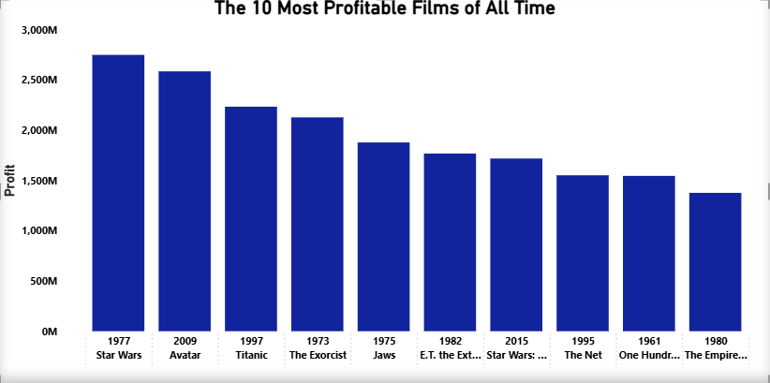
INSIGHT — Q1
Blockbusters Dominate the Profit Leaderboard
Spectacle sells but risk is invisible here
The all-time top 10 is dominated by big-budget blockbusters and franchise titles like Avatar, Titanic, Star Wars, The Exorcist spanning multiple decades. High-profile spectacle films can generate outsized returns even against large budgets.
A Top 10 list alone can't show us the films that spent just as big and failed, that risk stays invisible.
5
Notes:
The most profitable films of all time are dominated by big-budget blockbusters and franchises spanning decades — Star Wars, Avatar, Titanic, The Exorcist. But a Top 10 list can't show us the equally big-budget films that failed, so it doesn't tell us about risk.

Slide 6
INSIGHT — Q2
Adventure, Animation & Family Lead Profit
Ratings hold up too
The top 3 genres by profit all rate between 6.1 to 6.4 better than most other genres. Backing these genres doesn't mean trading away quality.
Recommendation
Prioritise Adventure, Animation and Family films, the highest-profit genres without sacrificing audience rating.
6
Notes:
Genre performance: Adventure, Animation and Family top the profit table, averaging $205–218M, while still holding ratings between 6.1 and 6.4 — no quality trade-off.

Slide 7
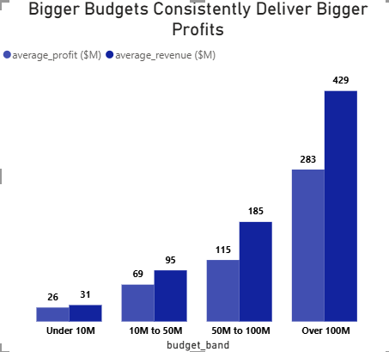
INSIGHT — Q3
Bigger Budgets, Bigger Profits (With Wide Variance)
0.57
Correlation between budget
and revenue: real, but moderate
Budget size shifts the odds but doesn't guarantee results, a companion scatter shows plenty of low-budget films outperforming, and big-budget films underperforming, their size.
Match budget size to genre and director track record don't chase size alone.
7
Notes:
Budget and profit rise together — Over-100M films average $283M profit vs $26M for sub-10M films — but the 0.57 correlation and scatter show real variance, so ROI and risk still matter.

Slide 8
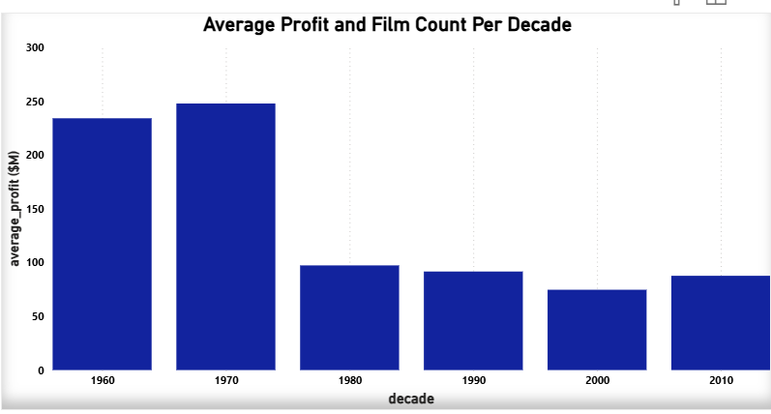
INSIGHT — Q4
Older Decades Look More Profitable, But Look out for Sample Size
The 1960s–70s average profit is driven by a tiny sample, just 71–133 films. Where blockbusters like Jaws and Star Wars dominate the mean. Later decades have 750+ films each, diluting the average profit across many mid-performers.
Total industry profit is likely far higher today, it's just spread across many more films. Recent decades are the more reliable baseline.
8
Notes:
Average profit per film looks highest in the 1960s and 70s, but those decades had only 71–133 films — a handful of outliers skew the mean. Recent, larger samples are more representative.

Slide 9
INSIGHT — Q5
Two Kinds of “Bankable”
Director | Films | Avg Rating | Total Profit ($M)
Steven Spielberg | 27 | 6.81 | 13,126.0
James Cameron | 8 | 7.10 | 6,296.6
George Lucas | 6 | 6.70 | 5,844.2
Peter Jackson | 11 | 7.15 | 5,645.5
Christopher Nolan | 8 | 7.64 | 3,149.6
Volume vs. efficiency
Spielberg averages ~$486M profit per film across 27 movies, while Cameron averages ~$787M per film across just 8, fewer projects, but a stronger per-film return. Nolan, meanwhile, leads the group on rating (7.64) despite having the lowest total profit here
“Bankable” can mean a long, consistent track record or fewer, higher-performing projects. The right pick depends on the strategy.
9
Notes:
Spielberg leads on total profit thanks to volume, but Cameron earns more per film. Nolan has the best rating of the top 10 despite the smallest total — profit and quality track records don't always agree.

Slide 10
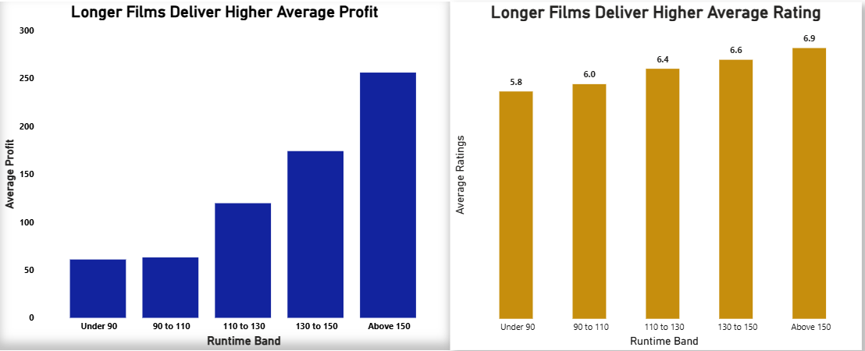
INSIGHT — Q6
Longer Films Win on Both Profit and Rating
Same band wins both: films Above 150 minutes average $256M profit AND a 6.9 rating. This is likely because studios reserve long runtimes for projects they already believe in.
10
Notes:
Both profit and rating climb steadily with runtime, peaking together above 150 minutes — likely a selection effect, since only high-confidence projects get greenlit at that length.

Slide 11
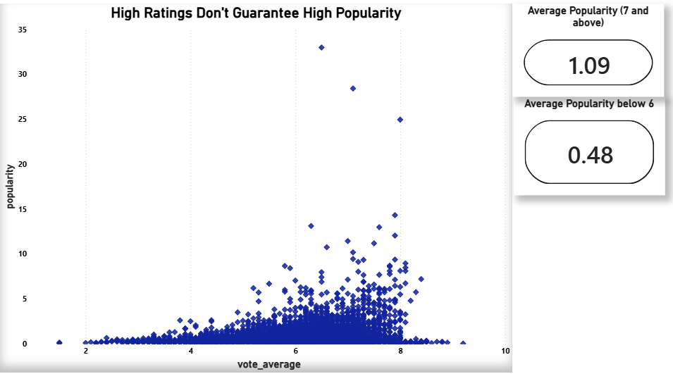
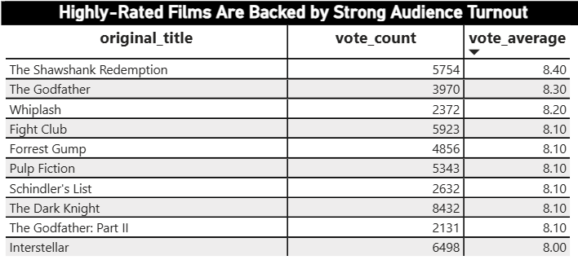
INSIGHT — Q7 & Q8
Hype, Quality and Profit Don't Always Align
Popularity roughly doubles from low to high-rated films, but the gap is driven by a few outliers, most films at any rating, sit near zero. None of these 10 top-rated films (500+ votes) overlap with the Profit Leaders list.
Takeaway: a studio chasing profit and a studio chasing prestige need different strategies — hype is not a reliable stand-in for either.
10
Notes:
Popularity roughly doubles from low to high-rated films, but with huge variance — and the highest-rated films (Shawshank, Godfather) don't overlap at all with the top profit leaders.

Slide 12
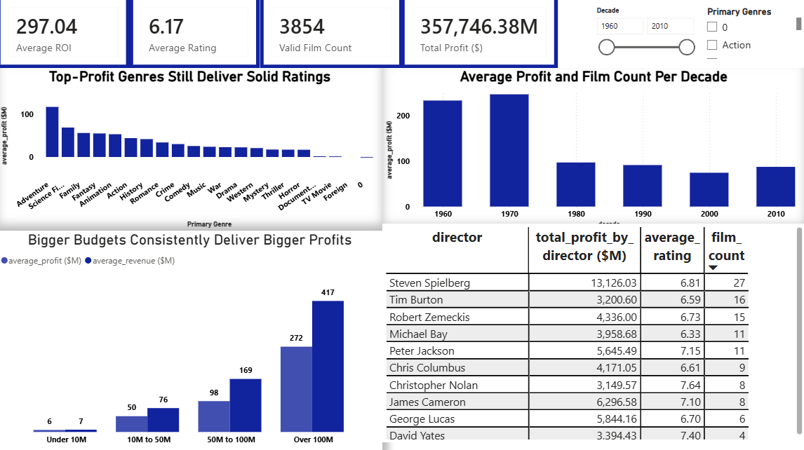
VISUALISE
One Page, Full Picture
An interactive Power BI dashboard with four headline metrics, genre and decade trends, budget comparison, and the top bankable directors that are filterable by decade and genre.
12
Notes:
The dashboard brings every insight together on one page, with slicers for decade and genre so the executive team can explore the data live.

Slide 13
EXECUTE
Three Recommendations for the $500M Investment
1
2
3
Prioritise Adventure, Animation & Family
Favour larger budgets where warranted
Back directors with a track record
These are the three highest-profit genres, averaging $218.0M, $210.6M, and $205.4M in profit respectively, while maintaining solid audience ratings (6.1 to 6.4). These genres deliver strong returns without sacrificing quality (Question 2)..
Films budgeted Over $100M deliver the highest average profit of $283M and revenue of $429M, with a moderate positive correlation (0.57) between budget and revenue. However, smaller budgets can deliver stronger ROI efficiency, so budget size should be matched to genre and director track record rather than pursued indiscriminately
Steven Spielberg, James Cameron, and George Lucas lead with total profits of $13.1billion, $6.3billion, and $5.8billion respectively across their qualifying films, combined with strong average ratings of 6.7 to 7.1. Prior box office success is a meaningful signal for future investment
13
Notes:
Three recommendations: back Adventure, Animation and Family; size budgets thoughtfully rather than by default; and prioritise directors with strong track records.

Slide 14
EXECUTE
Limitation and Next Question
LIMITATION
NEXT QUESTION
The data ends in 2015, over a decade of industry change (streaming, shifting habits) isn't reflected. Also more than half the dataset also lacked usable budget/revenue figures, so our profit findings rest on 3,854 of 10,865 films.
With more recent and complete data, I would prioritize understanding how streaming-era release strategies affect profitability as our current dataset only captures the traditional theatrical box office model.
14
Notes:
One honest limitation: the data stops in 2015 and only half the films had usable money data. Next, I'd want to study how streaming-era releases change profitability.

Slide 15
Thank You
Meridian Pictures | Capstone Project | July 2026
Notes:
Thank you — happy to take questions on the data, the methodology, or the recommendations.

